Slide 1
THE COMPANY
Presented By
Dominick DiTucci

Slide 2
When Do Brands Matter?
Case Study 1

Slide 3



CASE STUDY
When Do Brands Matter?
Brands are chosen over others because of…
Trust/Reputation
Quality Perception
Recognition
Positive Experiences

Slide 4
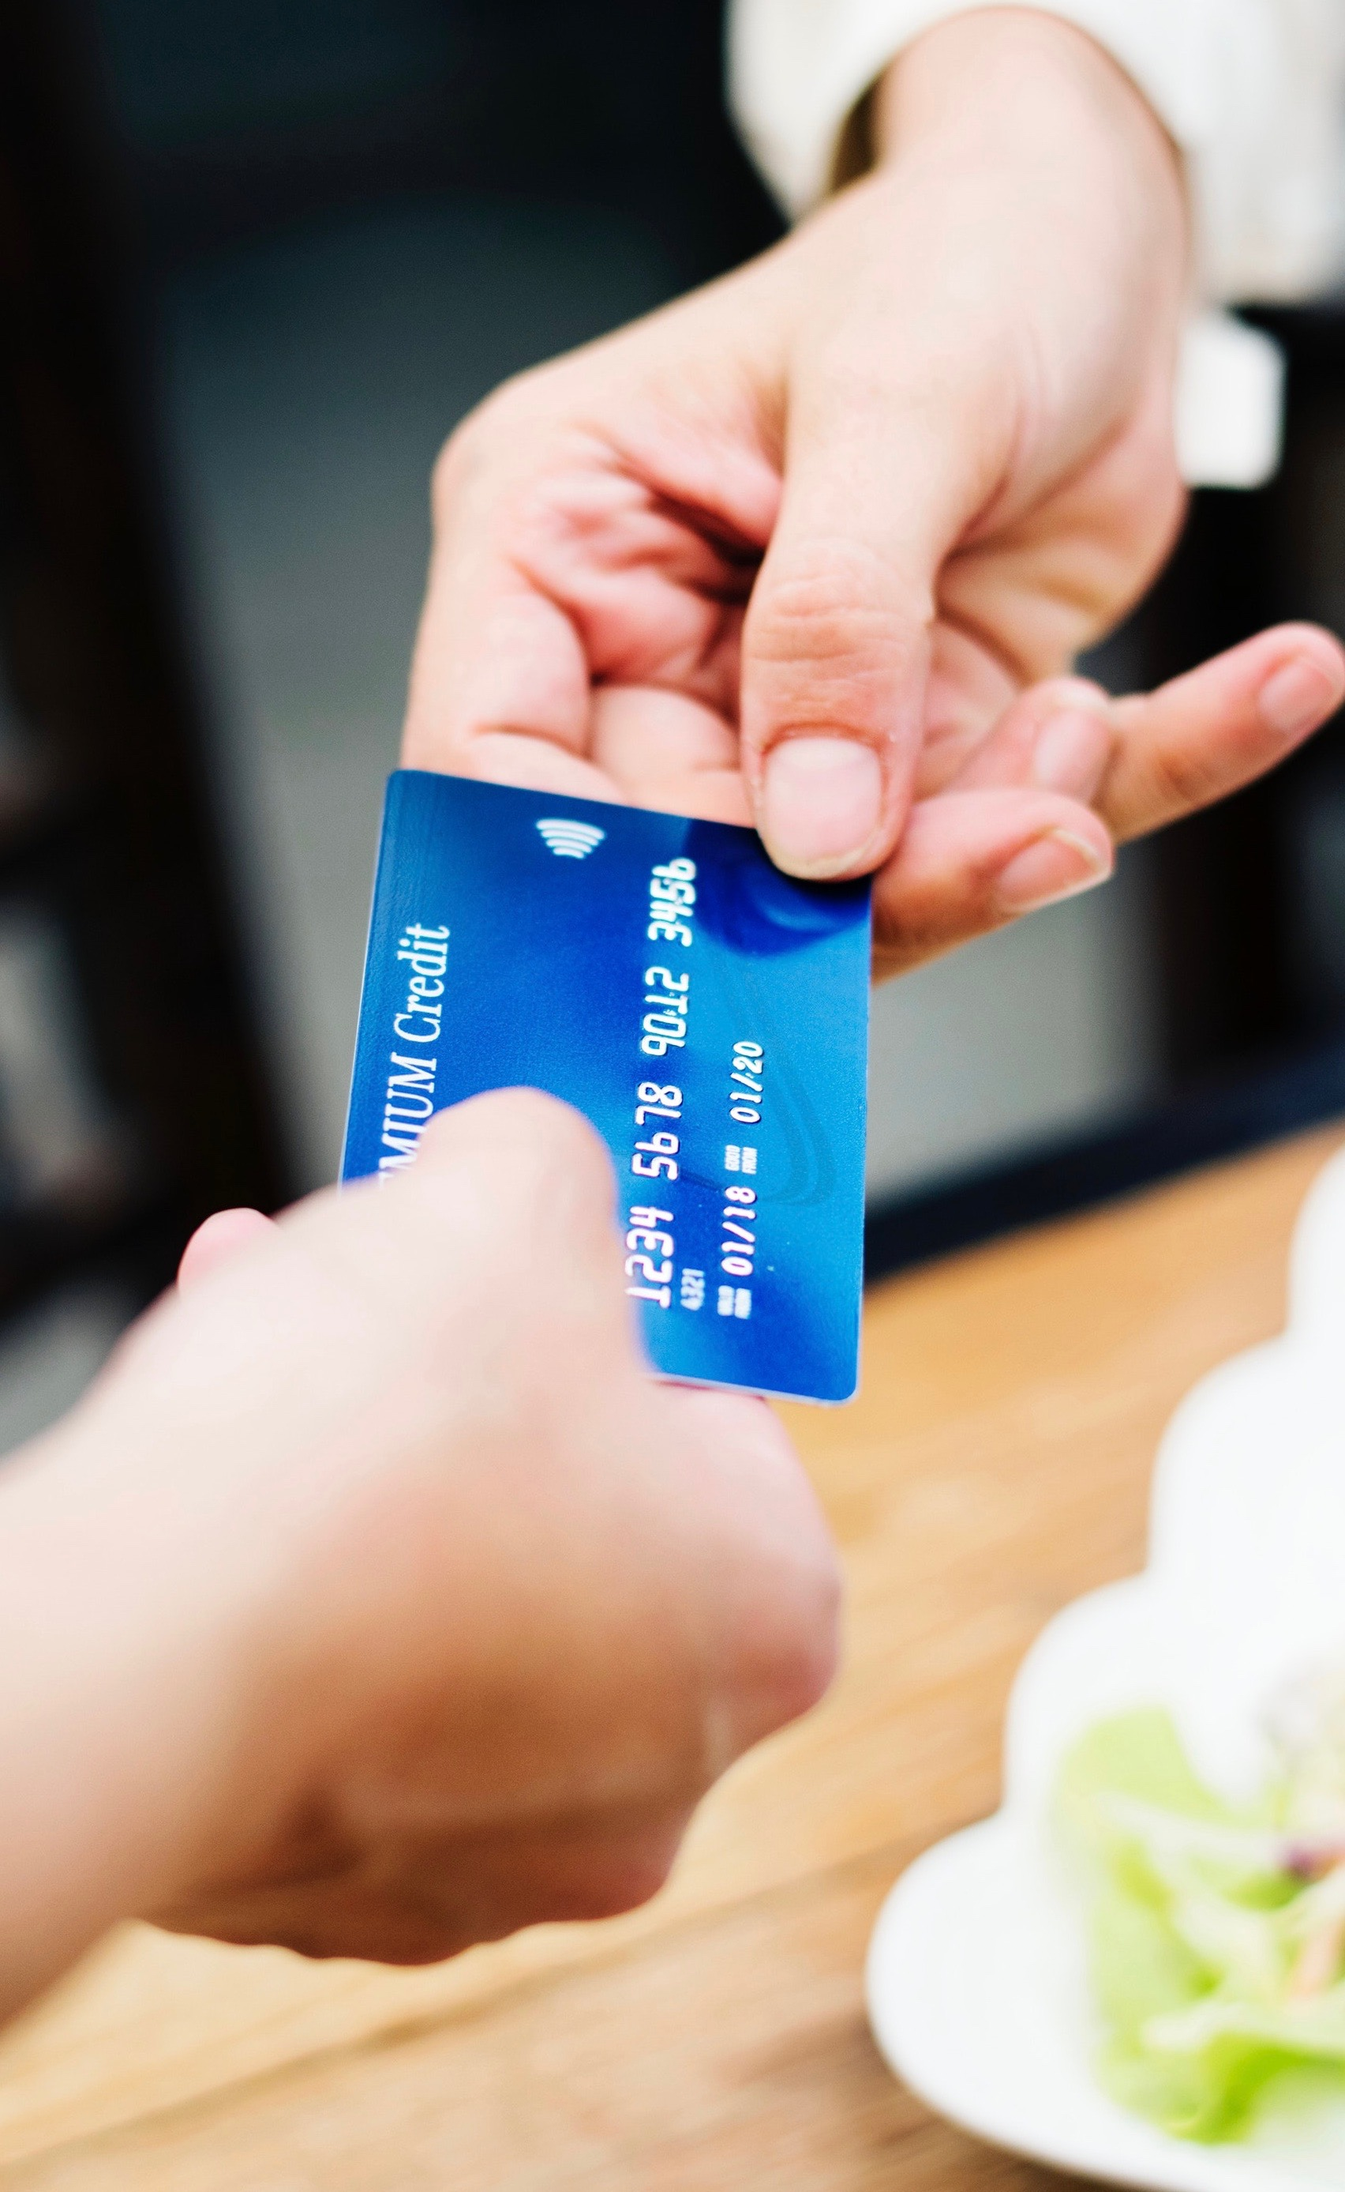
CASE STUDY
Do Brands Matter for Industrial Products?
Brands matter less for:
Low cost items
Disposable items
Brands matter more for:
Higher cost items
Long-term use items
To Whom…? Customers!

Slide 5
CASE STUDY
How Do We Know When Brands Matter?
When consumers pay more for similar items
Spending more on identical item
When consumers tell us they matter
Buying only specific brands
Indicating decision was based on brand

Slide 6
When and Why Do Brands Matter?
“When it is difficult to determine the quality of a product before purchase and the consequences of poor quality are significant, it makes economic sense for consumers to rely on brand names and the company reputations associated with them. By paying more for a brand-name product in those circumstances, consumers are not acting irrationally. Consumers know that companies with established reputations for consistent high quality have more to lose if they do not perform well—namely, the loss of the ability to continue to charge higher prices.”
~ Benjamin Klein
from “Brand Names”
The Library of Economics and Liberty
LINK

Slide 7
Detecting When Brands Matter
Find The Data:
Company data
Web scraping
3rd party data
Open-source
Purchase
Prepare The Data:
Clean
Standardize
Format for use

Slide 8
Analyze The Data:
Price/Volume Relationship
Does purchase volume of a more expensive brand indicate preference?
Reviews
Which brands are consistently rated higher than lower-priced identical products?
Sentiment Analysis: Can we find positive/negative sentiment for brands using NLP?
Customer Profiles
Find demographics that show strong brand preferences
Detecting When Brands Matter

Slide 9
Making Recommendations
Case Study 2

Slide 10
CASE STUDY
The Raw Data
"order_number" "l1" "l2" "l3" "sku" "brand"
"168266" "Power Tools" "Power Saws and Accessories" "Reciprocating Saw Blades" "265105" "2768"
"123986" "Safety" "Spill Control Supplies" "Temporary Leak Repair" "215839" "586"
"158978" "Hardware" "Door Hardware" "Thresholds" "284756" "1793"
"449035" "Electronics, Appliances, and Batteries" "Batteries" "Standard Batteries" "12579" "1231"
"781232" "Motors" "General Purpose AC Motors" "General Purpose AC Motors" "194681" "2603”
"701116" "Motors" "General Purpose AC Motors" "General Purpose AC Motors" "310296" "1068"
"555497" "Motors" "Motor Supplies" "Capacitors" "306732" "1068"
"282317" "Safety" "Footwear and Footwear Accessories" "Insoles" "148549" "2696"
"644437" "Hand Tools" "Sockets and Bits" "Crowfoot Socket Wrenches" "283869" "3356"
"830236" "Security" "Two Way Radios and Accessories" "Handheld Two Way Radios" "99449" "2830"
"483827" "HVAC and Refrigeration" "Air Filters" "Pleated Air Filters" "301809" "123"
"595763" "Cleaning" "Trash Bags and Liners" "Trash Bags" "268122" "4355"
"834301" "Hand Tools" "Tool Storage and Transfer Tanks" "Tool Storage Accessories" "285224" "4692"
"190274" "Electrical" "Raceways" "Raceways" "205118" "2438”

Slide 11
CASE STUDY
Recommendation System Approach
Market Basket Analysis
Use association analysis to find items that are frequently purchased together (frequent itemsets)
Association Rule Mining
Generate rules for frequent itemsets with metrics that can adjusted as desired for specificity
Make Recommendations
Use association rules to recommend other products that are frequently associated. Use popular products to drive sales of others

Slide 12

This can all be done with minimal data preparation and the MLXtend library for python
CASE STUDY

Slide 13
CASE STUDY
Recommendation System Implementation
first
second
last
Data Prep
Group by order number
Predict L3 Category
One-hot encode
Assoc. Rules
Apriori algorithm
Find frequent itemsets
Generate Association rules
Get Recs.
Filter associations
Support
Lift
Confidence

Slide 14
CASE STUDY
Outcome
Key Terms
Support: Relative frequency items are in the same transactions.
Lift: Ratio of the observed support to what is expected if the association was random Greater than 1 = “interesting” association
Confidence: Reliability measure for the association rules.
Recommendation Parameters
Support >= 1
Lift >= 6
Confidence >= 80%

Slide 15
CASE STUDY
Recommendations Generated
(Sample Best/Worst)
Antecedents (Items) | Consequents (Recommendations) | Support | Confidence | Lift
Lock Nuts, Hex Nuts, Lock Washers | Flat Washers | 0.013127 | 0.923201 | 7.892349
Trash Bags, Disposable Gloves, Toilet Paper | Paper Towels, Rolls | 0.010004 | 0.822864 | 12.547244
Lock Nuts, Flat Washers, Hex Nuts, Lock Washers | Hex Head Cap Screws | 0.011447 | 0.872019 | 8.676589
Flat Washers | Pipe Sealant Tape, Lock Washers | 0.010042 | 0.085847 | 6.956559
Cut-Resistant Gloves | Standard Batteries, Cut-Resistant Sleeves | 0.010767 | 0.086561 | 6.180698
Flat Washers | Hex Nuts, Black Pipe | 0.010996 | 0.094007 | 6.888870

Slide 16

CASE STUDY
Notebook & Code

Slide 17
CASE STUDY
Improvements
Automate pipeline
Automate formatting of data for new orders
Use more varied data for better recs
Increase strictness of parameters
Periodically retrain model
Explore more complex association mining methods

Slide 18

THANKS!
Any questions?
You can find me at
www.linkedin.com/in/dominick-ditucci
www.github.com/dditucci

